Slide 1

Suffering
Professional Ethics
Joseph E Thornton MD
UF-VA Bioethics Unit
International Bioethics Chair
A Cooperating Center with the World Medical Association
June 13, 2024
Bioethics Foundation Course for Medical Students Medical College of Panimalar

Slide 2
Disclosures
Finance:
Employee of the University of Florida
Associations:
American Psychiatric Association
Opinion
Solely my own and does not represent a group

Slide 3
Learning Objectives
At the end of this session the participant will be able to
Discuss different types of suffering
Describe the role of the health professional in relating to patients who suffer

Slide 4
OVERVIEW
Brief Review of Ethical Principles
What is Suffering
Who Suffers
Why Suffer
Professional Suffering

Slide 5
The Clinical Mission
Save
Save Lives
Alleviate
Alleviate Suffering
Value
Value autonomy
Engage in
Engage in therapeutic community
S-A-V-E

Slide 6


Slide 7
UNESCO 15 Bioethical Principles
Article 3 – Human dignity and human rights
Article 4 – Benefit and harm
Article 5 – Autonomy and individual responsibility
Article 6 – Consent
Article 7 – Persons without the capacity to consent
Article 8 – Respect for human vulnerability and personal integrity
Article 9 – Privacy and confidentiality
Article 10 – Equality, justice and equity

Slide 8
UNESCO Bioethical Principles
Article 11 – Non-discrimination and non-stigmatization
Article 12 – Respect for cultural diversity and pluralism
Article 13 – Solidarity and cooperation
Article 14 – Social responsibility and health
Article 15 – Sharing of benefits
Article 16 – Protecting future generations
Article 17 – Protection of the environment, the biosphere and biodiversity

Slide 9
UNESCO Bioethical Principles
Article 11 – Non-discrimination and non-stigmatization
Article 12 – Respect for cultural diversity and pluralism
Article 13 – Solidarity and cooperation
Article 14 – Social responsibility and health
Article 15 – Sharing of benefits
Article 16 – Protecting future generations
Article 17 – Protection of the environment, the biosphere and biodiversity

Slide 10
What is Suffering ?
Pain
Hunger
Fear
Loneliness
Hopelessness
Confusion

Slide 11
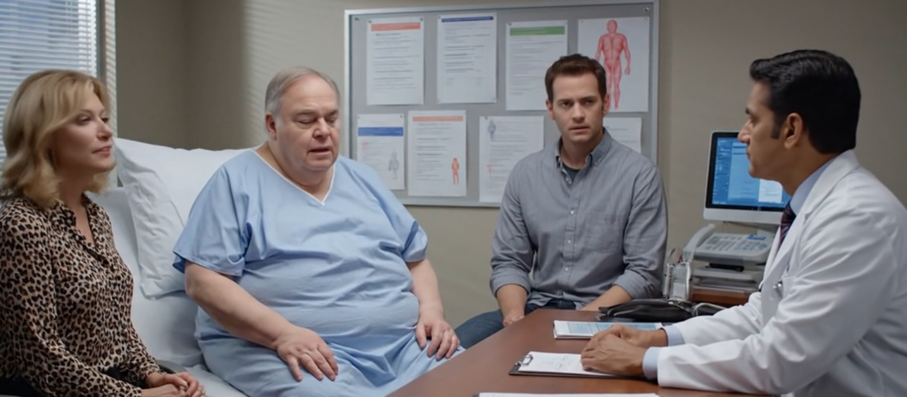
Case - Alfred
62 year old obese married grandfather
presents short of breath,
stating he cannot live like this
and wishes he could take a pill and die.

Slide 12
Person
Related Person
Professional
Public
Who
Suffers ?

Slide 13
What is Suffering ?
Pain
Hunger
Fear
Loneliness
Hopelessness
Confusion

Slide 14
Case - Alfred
62 year old obese married grandfather presents short of breath, stating he cannot live like this and wishes he could take a pill and die.
Who are the involved parties ?
Are there differential benefits and risks ?

Slide 15
Why suffer
Sufferer
Live
Hope
For others
Others
Solidarity
Love
Hope

Slide 16
Professionalism
Healthcare is the vocation of suffering
  Help others live
  Help others hope
  Provide meaning

Slide 17
ETHICS OF RESPONSE
Activist Ethics
Beyond the Bedside
Local
National /International
Local Communications
  Infection control
    Physical distancing
    Masks
    Telework
    Telehealth
Community Engagement
  Education
  Masking
  Vaccine
Participation in the International Bioethics Chair Webinar Series

Slide 18
Questions
?
Discussion

