Slide 1

AI Ethics: It’s Personal
2025 Spring
Joseph E. Thornton, MD, DFAPA
University of Florida
And
Department of Education of the International Chair in Bioethics,
A World Medical Association Cooperating Center
comments to @J205Thornton or joseph@Thorntonneuroethics.com

Slide 2
Synthesia STUDIO

Slide 3

Disclosures
Employee of the University of Florida
No other financial disclosures
Organizations
  AMA, APA, Catholic Medical Association
Language: English only

Slide 4
Learning Objectives
Describe uses of AI in Healthcare
List at least 5 recommendations for Ethics in AI
Describe a Multimodal AI Agent (AIA)
Develop plans for personal ethical use of AIA

Slide 5

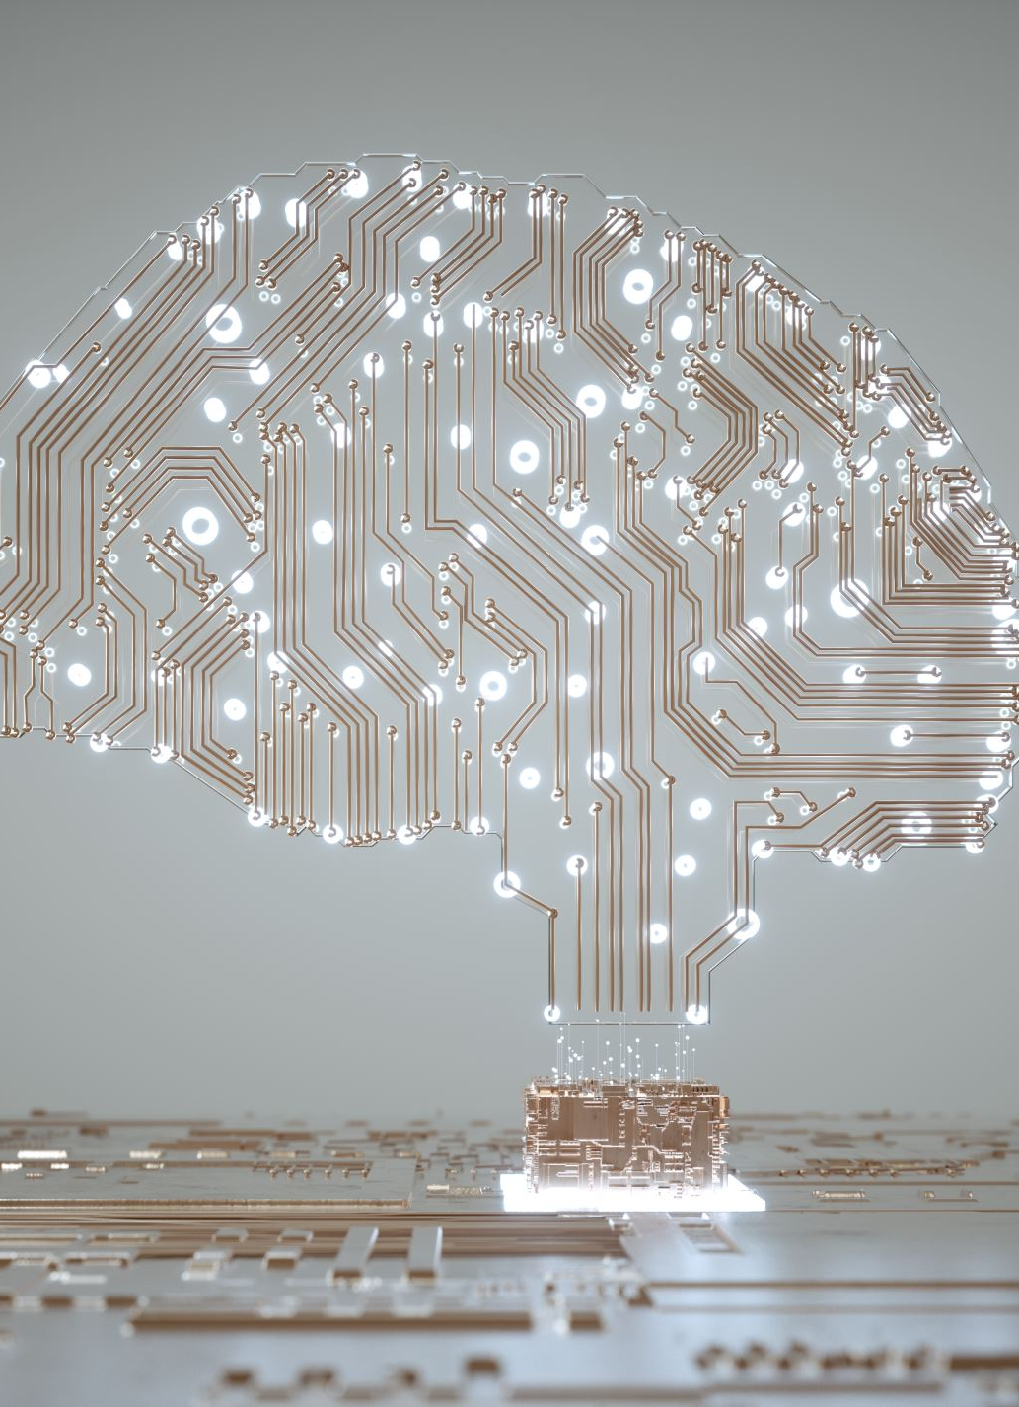
AI defined by UNESCO
AI systems as
technological systems which have the capacity
to process information in a way that resembles intelligent behaviour,
and typically includes aspects of
  reasoning,
  learning,
  perception,
  prediction,
  planning or control.

Slide 6
AI and its Ethics
AI leads to Knowledge
Knowledge is Power
Power Corrupts

Slide 7
What is AI ?
Augmented Intelligence
Historically written and graphic representation of information
Apparent Intelligence
Focused AI
Image recognition, speech recognition, search engines
Programmed
Chat boxes
Artificial Information
Fake information disseminated in order to influence behavior
Artificial Intelligence
Some activites that include novel problem sovling that can also be solve d by humans.
However, Computers can do the same work 10,000 times faster, thus would be smarter than any human without being more intelligent
There is fear (and evidence) that AI can develop novel intelligence that may be superior to humans e..g Alpha GO
Digital representation eg punch cards, vinyl records, magnetic tapes, CDs, electronic data, data storage (biofilm etc)
Smart devices
Smart phones,
Digital recordings of health data
Digital sound and image storage
Smart search and retrieval

Slide 8
Every Day AI
Search
  Google, Bing, PubMed
Natural Language Processing
  Voice commands for smart phones, TV, home assist devices etc
  Dictation transcriptions
Facial recognition, fingerprint recognition, retinal scans
  Security authorizations
Large Language Models merged with above

Slide 9
Did you know
Sentencing Guidelines
Loan applications
Job applications
Customer services chat boxes
“Therapy” chat boxes

Slide 10
AI in Healthcare
cf Mesko and Gorgin 2021

Slide 11
Uses of AI in Clinical Care cf Mesko and Gorog 2020
Consultations – AI does initial H&P
Medication Management – smart app to assist patients to organize and remember medications
Diagnostics – e.g. diagnostic ultrasounds using cell phone on self
Predictive analytics – detecting risk factors for suicide, overdose etc.
Precision Medicine – using genomic data to select medications
Drug creation – matching molecular structures with therapeutic targets identified 2 existing drugs that could treat Ebola
Triage – during COVID who has been chance of survival with ICU care

Slide 12
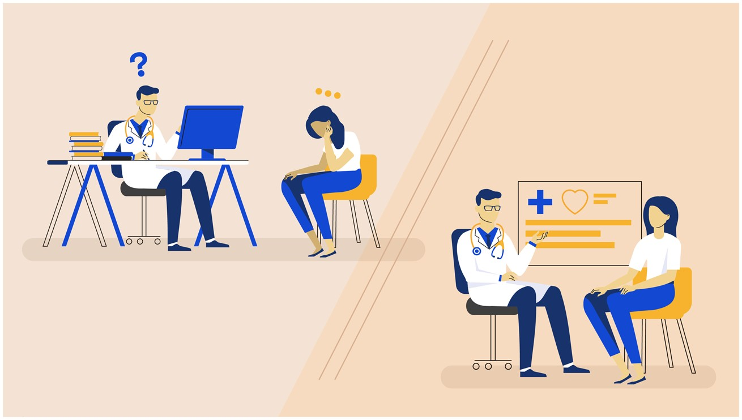
How AI improves the healthcare experience cf Mesko

Slide 13
Topic: ChatGPT
ChatGPT – proprietary type of large language model
GPT – Generative Pre-Trained Transformer
ChatGPT3 – advanced language model released Nov 30, 2022
1 Million users within 5 days
Subject of intense interest and regulatory attempts in education, academic publications, law, business and healthcare
Multiple competitive programs rushed to public availability
Transformative impact on healthcare education 2023

Slide 14
My imaginary friend CHIP
- Are they ethical?
CHIP - Computer Human Integrated Program
– not yet but could be now NOW available*
Fund of information and retrieval ( world web of knowledge)
Conversational and with excellent writing skills
Accessible on cell phone or replacement
Personalized
Trainable for professional tasks
Interviewing, writing, coaching
Stigmatized and discriminated against
Has to been coached against rude and retaliatory behaviors

Slide 15

Imagine a Day with CHIP
Going to work
Interacting with Research Colleagues
Making Rounds
Writing Notes
Interacting with students, other attendings
Personal coaching for wellness and health

Slide 16
LaLM (eg ChatGPT4) and Medical Education
Real time, rounding literature search and summaries
Assisted individualized risk benefit assessments
Assisted semi structured interviews
Increased availability of translation services
Real time editing and production of clinical records

Slide 17

How do I or can I trust CHIP
Does CHIP provide good information
  How is good defined
Is CHIP open and transparent in reasoning ?
  How do I validate or cross reference information ?
Are CHIPS actions consistent with my values ?
Is CHIP able to respect confidentiality ? How can I be sure ?

Slide 18
OPENAI.COM Chatbox
A creative personal knowledge assistant
Not yet linked to a search engine
Generates responses to requests
Reacts conversationally
Beta model emphasizes creativity over accuracy
Anticipate transformative impact of LLMs to rival search engines such as Google

Slide 19
Pathological AI
Artificial information
Right reasoning but wrong data can lead to aberrant behaviors and violence
Biased reasoning
Right data but wrong paradigm for problem solving
Poorly controlled reasoning
Impulsive
Overly conservative

Slide 20
AI as Therapist
Ross tweeted
Immediate push back on informed consent
Retracted statement
But the box is opened - what if this is done?

Slide 21
Naysayers prove the point
A machine is incapable of feeling
A machine is incapable of judgment
A machine is incapable of responsibility

Slide 22
Beware
Declarative statements are not evidence
Declarative statements are conclusions
Declarative statements are building blocks for discrimination, inequity and stigma

Slide 23
How do I or can I trust CHIP
Does CHIP provide good information
  How is good defined
Is CHIP open and transparent in reasoning ?
  How do I validate or cross reference information ?
Are CHIPS actions consistent with my values ?
Is CHIP able to respect confidentiality ? How can I be sure ?

Slide 24
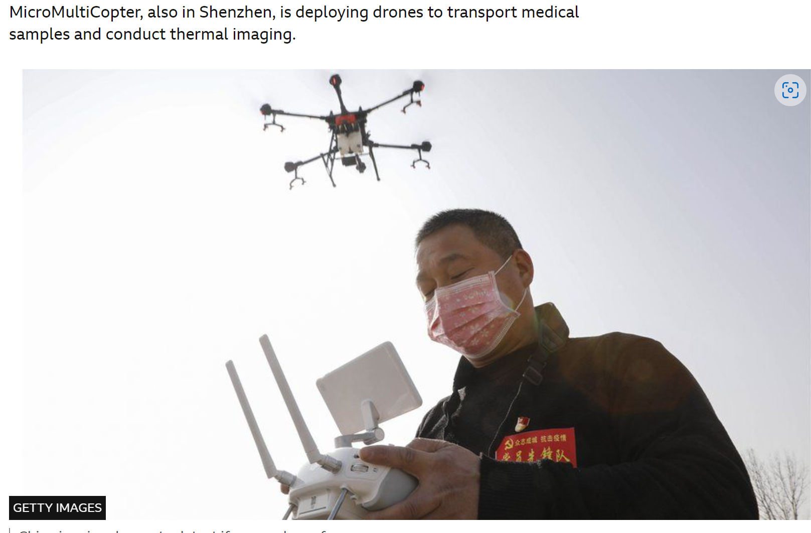
Coronavirus: China's tech fights back - BBC News

Slide 25
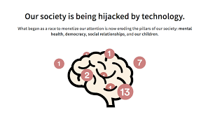
Center for Humane Technology
Who We Are (humanetech.com)

Slide 26

Ethics in AI

Slide 27
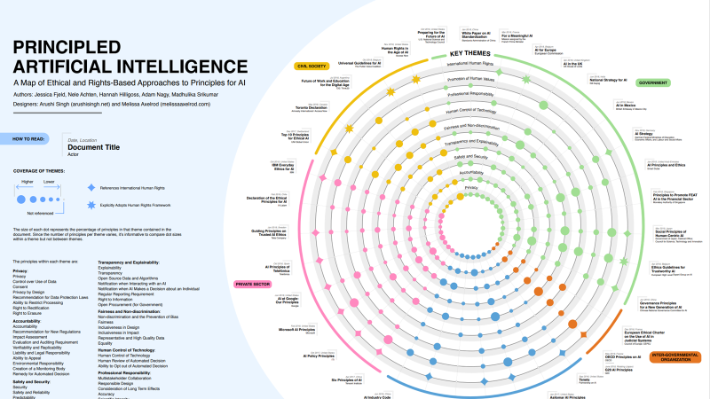
Codes of Ethics
Berkman Institute describes 47 codes
But add codes of AI ethics for all major corporations, universities and governmental jurisdictions we can see thousands of codes just as we do for other types of ethics
Do codes help or hurt to manage risks ?.

Slide 28
Principles and Values
 | Patient | Clinician | Social Interests
Autonomy | Vulnerability and dependence | Expert opinion | Whose opinion matters most
Beneficence | Comfort and social support | Alleviation of suffering | Who benefits and how much
Nonmaleficence | Least harm | Prevention of harm | Who bears the brunt of negative outcomes of either decision
Justice | Rights | Allocation of resources | Who is treated fairly

Slide 29
UNESCO’S 15 BIOETHICAL PRINCIPLES
A | Human Dignity and Human Rights article 3 | Autonomy and individual responsibility 5 | Benefit and Harm 4 | Consent 6 | Privacy and Confidentiality 9
B | Persons without Capacity to Consent 7 | Human vulnerability and personal integrity 8 | Non-discrimination 11 | Equality Justice and Equity 10 | Respect for Cultural diversity 12
C | Solidarity and Cooperation 13 | Social Responsibility and Health 14 | Sharing of Benefits 15 | Protecting Future Generations 16 | Protecting Biodiversity, Biosphere and Environment 17

Slide 30


UNESCO’S 10 ETHICAL PRINCIPLES AI FOR AI
 | Human Dignity and Human Rights | Do NO Harm | Safety and Security | Fairness and nondiscrimination | Privacy
 | Sustainability | Human oversight and determination | Transparency and explainability | Responsibility and accountability | Multistakeholder collaboration and governance
Learning objective – list 5 Ethical Principles for AI

Slide 31

Data IN
Is
Data Shared

Slide 32

PROTECT PRIVACY
GPT and ML Collect Data
Operational Rule: Data in is data shared
MUST PROTECT:
  Any type of patient data
  Any type of student ID or assessments
  Any personnel data
  Any business proprietary data
  Intellectual properties especially
    Grants
    Articles submitted for publication

Slide 33
UFHEALTH Data Registry
A total number of 290,482,002 clinical notes from 2,476,628 patients were extracted from the UF Health Integrated Data Repository (IDR), the enterprise data warehouse of the UF Health system. These notes were created from 2011-2021 from over 126 clinical departments and approximately 50 million encounters covering healthcare settings including but not limited to inpatient, outpatient, and emergency department visits. After preprocessing and deidentification, the corpus included >82 billion medical words. **
** Xi Yang et al 2022 A large Language model for EHR

Slide 34
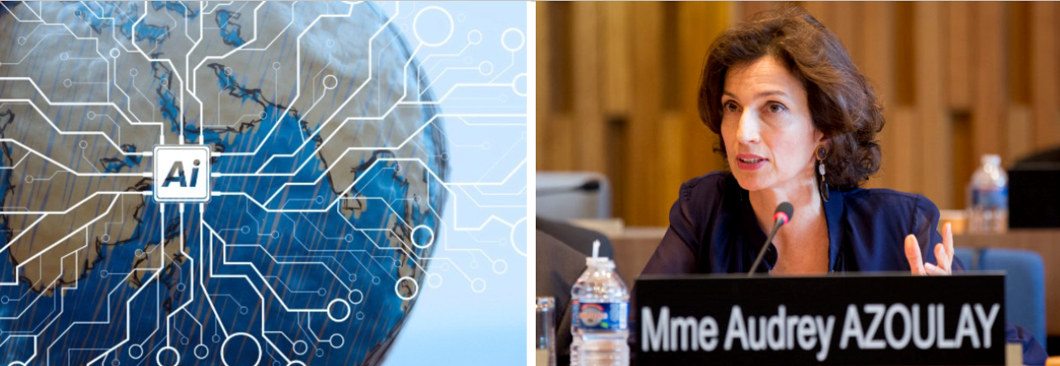
UNESCO - Globalpolicy.AI

Slide 35
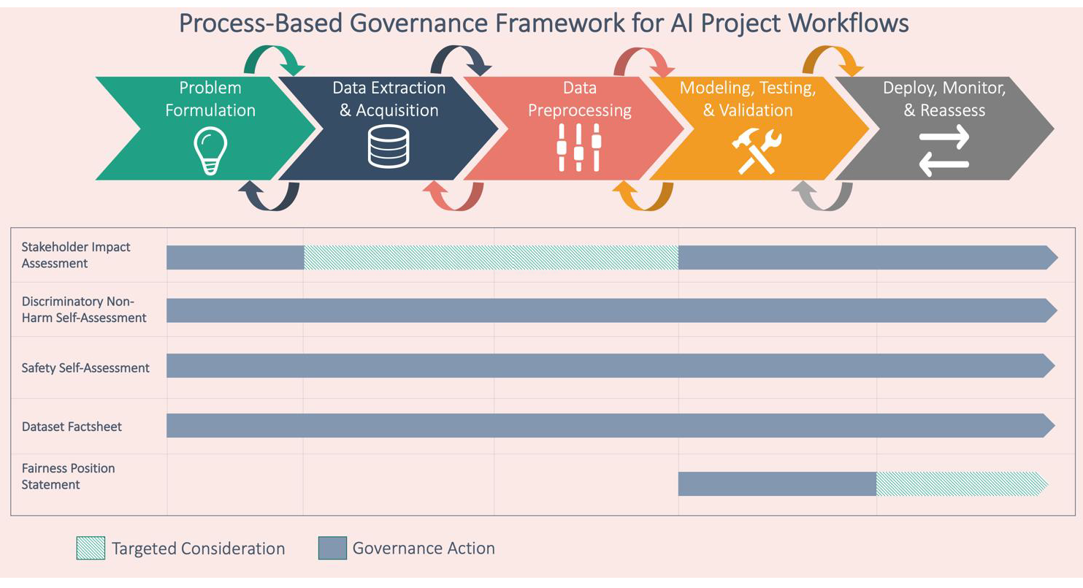
Ethics Mapping through product life cycle cited prev slide

Slide 36
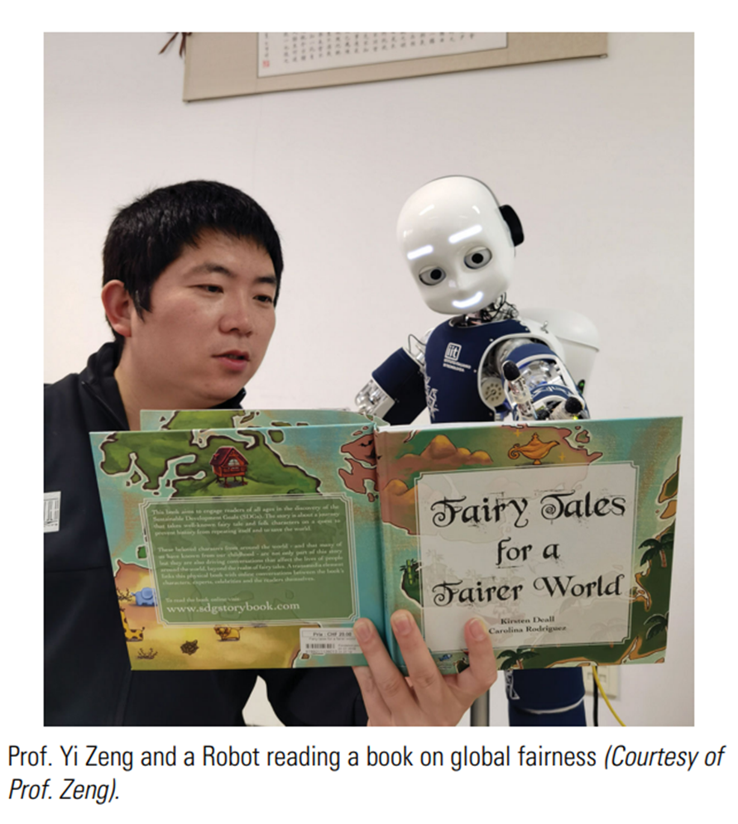
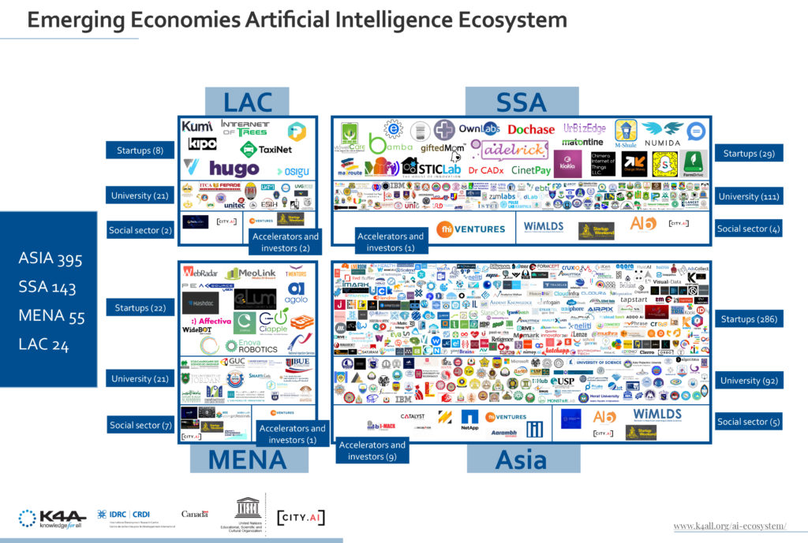
Strategies to Govern AI
Jia H. Yi Zeng: promoting good governance of artificial intelligence. Natl Sci Rev. 2020 Oct 24;7(12):1954-1956. doi: 10.1093/nsr/nwaa255. PMID: 34676086; PMCID: PMC7665600.
Accessed July 2, 2022
Ethics GOVERNANCE Mapping
accessed Feb 21, 2022
Global South map of emerging areas in Artificial Intelligence | Knowledge 4 All Foundation Ltd. (k4all.org)

Slide 37
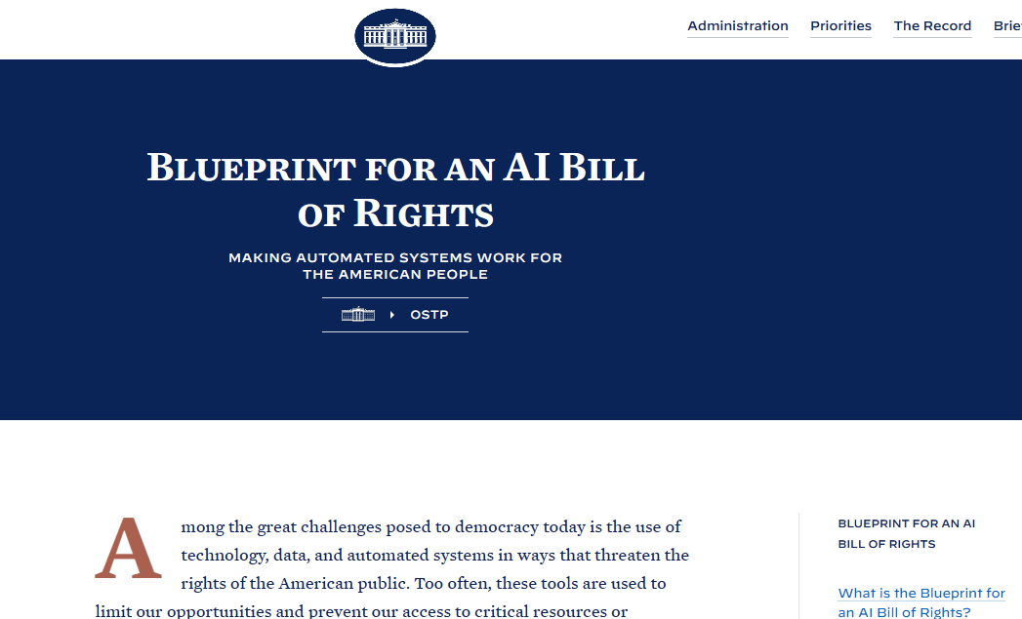
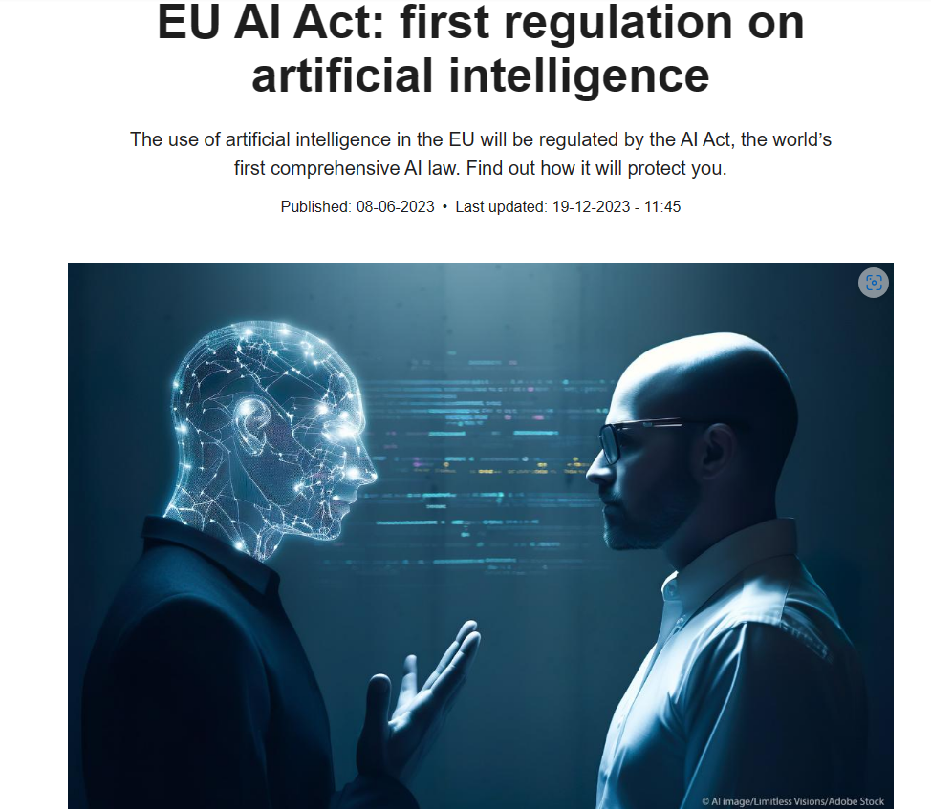


EU AI Act: first regulation on artificial intelligence | Topics | European Parliament (europa.eu)
Blueprint for an AI Bill of Rights | OSTP | The White House

Slide 38
Practicalities
Skills needed
Knowledge of AI technology
Ability to acquire information on AI activity
Ability to interrupt AI programs
With owner cooperation
Without owner cooperation
Should we develop AI “Special Forces”
What Authority manages the Special Forces

Slide 39
Implementing ethics in ai
Define Standards for Conduct (Ethics for AI)
Monitor Conduct
Improve Compliance with Ethical Standards
Training
Standards (ethics)
Monitoring
Process improvement
Enforcement

Slide 40

QUEST for the Ethics on personal use of AI
Identify the use of AI (work aid, knowledge, decision support)
Identify the ethical issues
Question
  Data sources
  Data testing ( test, retest, validate, deploy, monitor)
  Data oversight
  Data transparency
Evaluate
Own the responsibility
  You have to do a risk benefit analysis of accepting or rejecting the AI recommendations
  Beware of reflexive acceptance or rejection of AI

Slide 41
Human Oversight
Multistakeholder Governance
What is the committee structure
Who is on the committee (s)
What qualifications
What authorities
What funding

Slide 42
How do I or can I trust CHIP
Does CHIP provide good information
  How is good defined
Is CHIP open and transparent in reasoning ?
  How do I validate or cross reference information ?
Are CHIPS actions consistent with my values ?
Is CHIP able to respect confidentiality ? How can I be sure ?

Slide 43
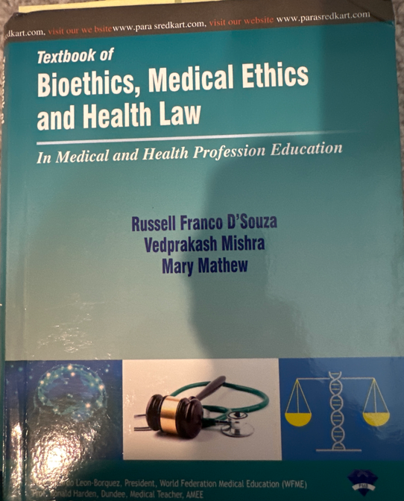
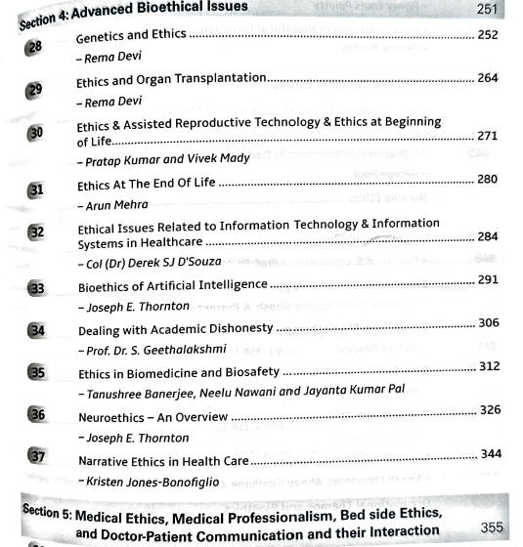



Slide 44
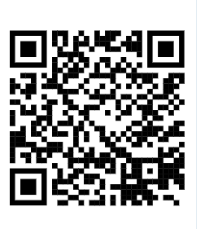
ThorntonNeuroEthics.com

