Slide 1



Ethically Developing AI Tools to Assist in Hospitalized
Patient Autonomy
Ana Silva, MD
PGY3 Psychiatry Resident, University of Florida College of Medicine
Joseph Thornton, MD
Clinical Associate Professor of Psychiatry, Founding Director for the UF-VA UNESCO Bioethics Unit

Slide 2
Disclosures
Drs Silva and Thornton have no financial disclosures
Nor Conflicts of Interest.
Dr Silva is a PG4 Resident in Psychiatry with University of Florida
Dr Thornton is an employee of University of Florida
Bias disclosure on this topic:
  Drs Thornton and Silva use AI tools
  and cautiously optimistic about implementation in healthcare.
Use of AI Programs in this presentation:
  Microsoft: Office 365, Co-pilot, OpenAI ChatGpt4 , Dalle-E,
  Humanizer Pro , Adobe AI); Anthropic: Claude 3;
  Synthesia; Google Gemini,
  All references verified; Prompt history available
All content selections and accuracy responsibility
are with the authors., Dr Thornton is senior.

Slide 3
Learning Objectives
Describe
How the use of AI tools in health care may impact patient autonomy.
Demonstrate
Understanding of Informed Consent
Describe
The purpose of a local AI Ethics Advisory Board)

Slide 4

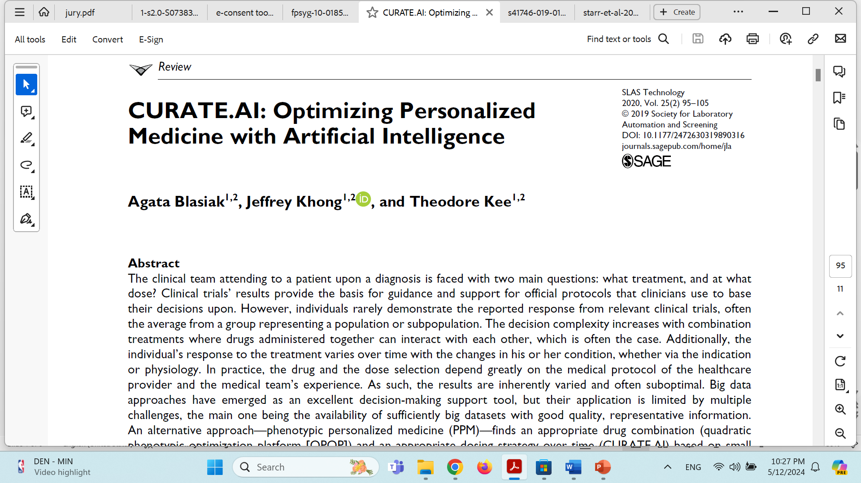
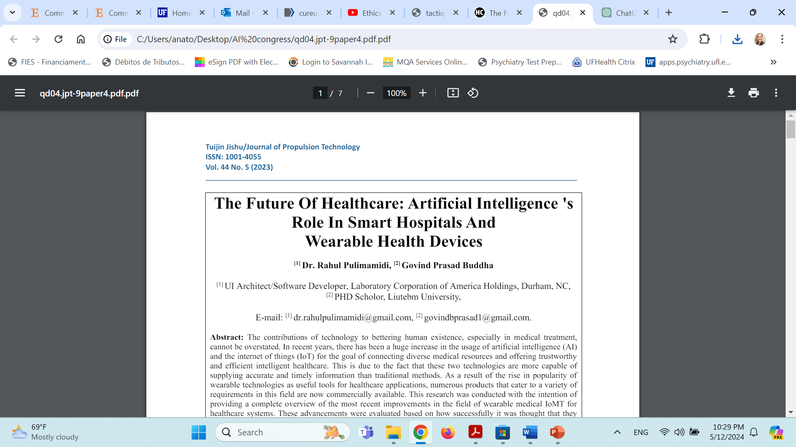
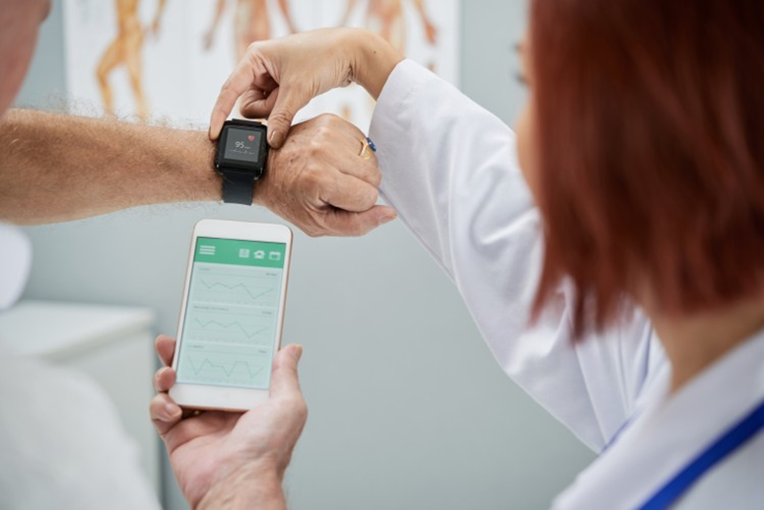
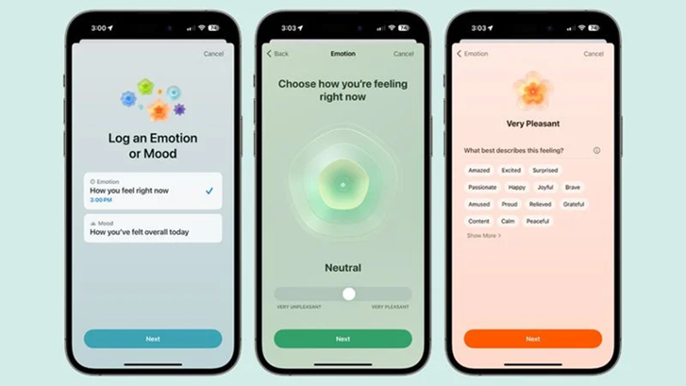
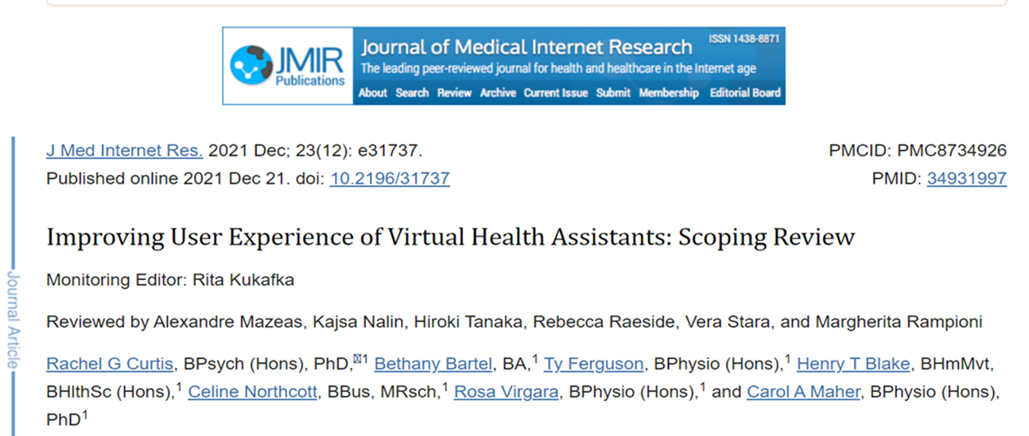
AI In Medicine
Reshaping the landscape of Healthcare
Notes:
The potential for Artificial Intelligence (AI) in medicine is tremendous. We find ourselves in the course of a revolution where AI is reshaping the landscape of healthcare. From the possibility of personalized medicine, where data from mobile and wearable health devices, genetic information, electronic health records, and lifestyle factors converge to customize treatment plans and predict diseases, to the advent of virtual health assistants, designed to provide users with healthcare guidance and support, AI is revolutionizing how we deliver and receive medical care.

Slide 5
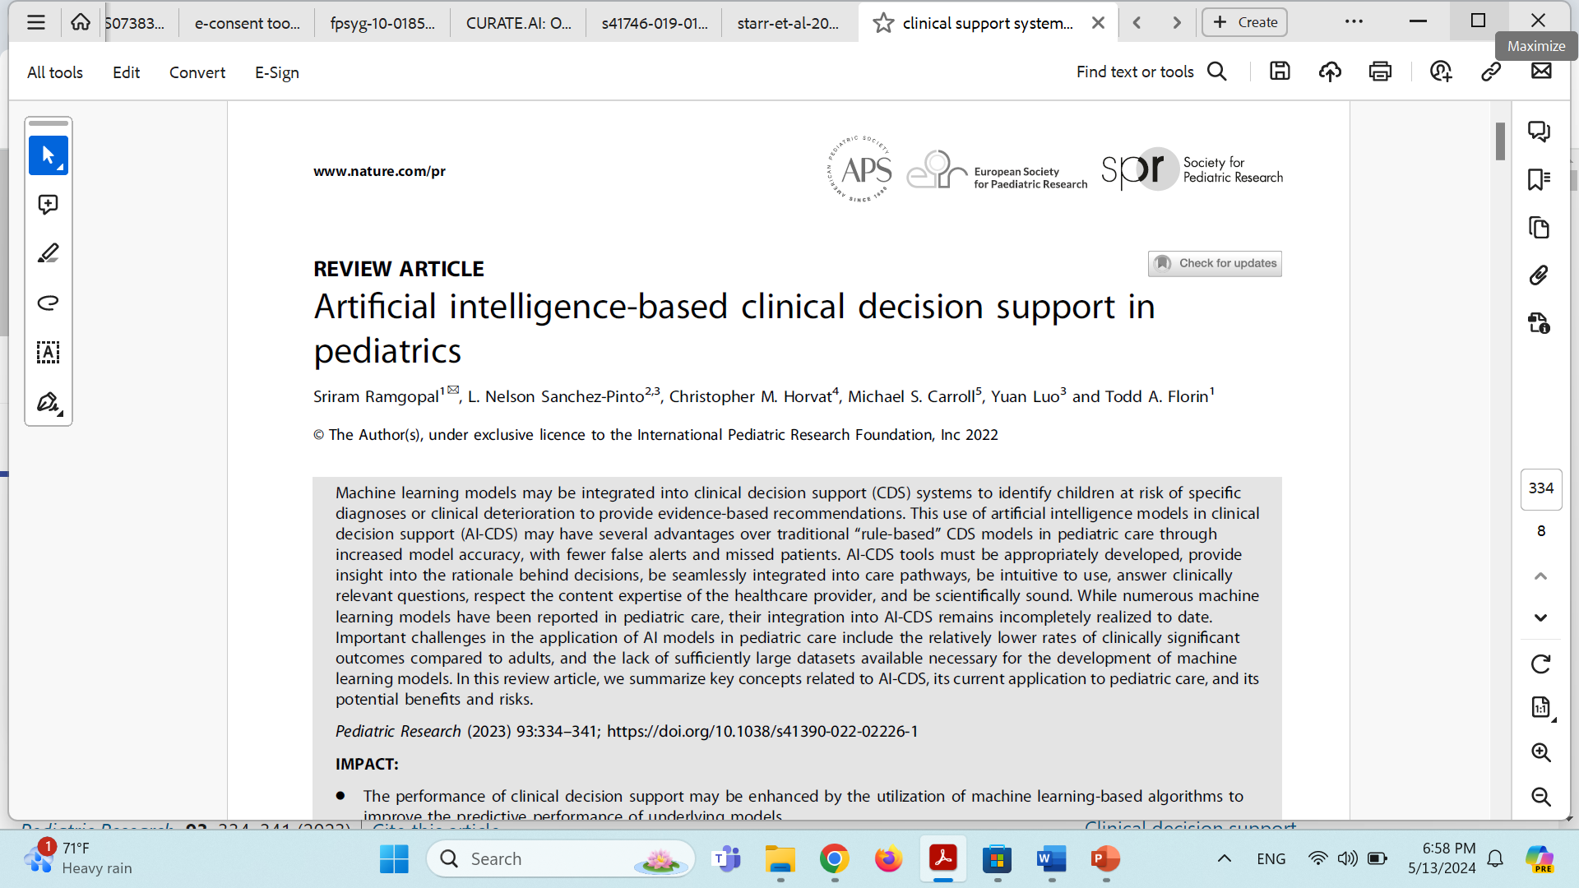

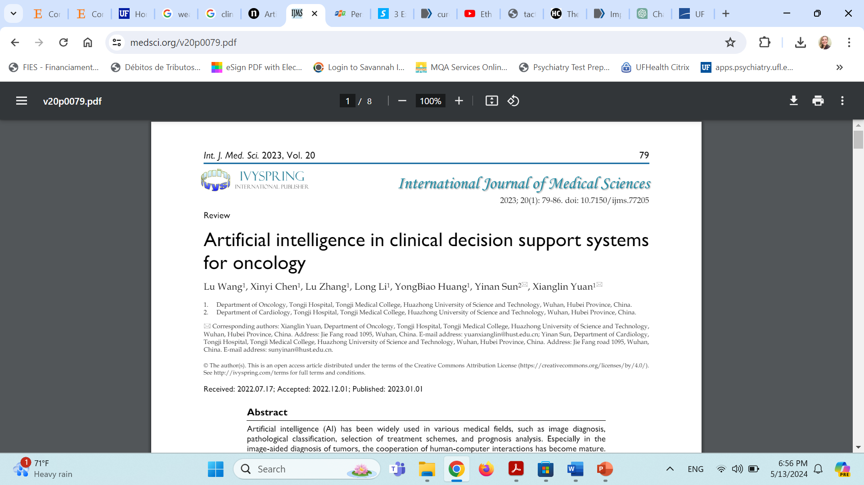
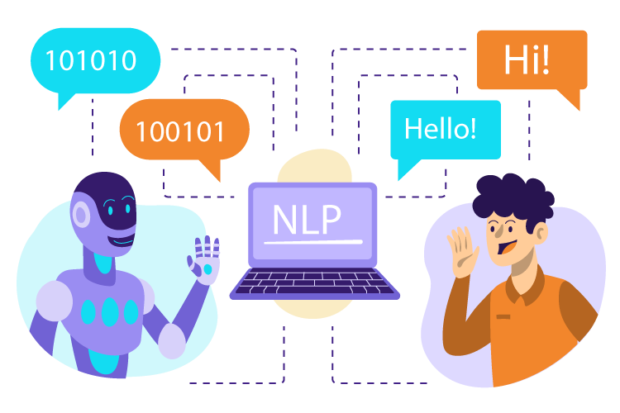
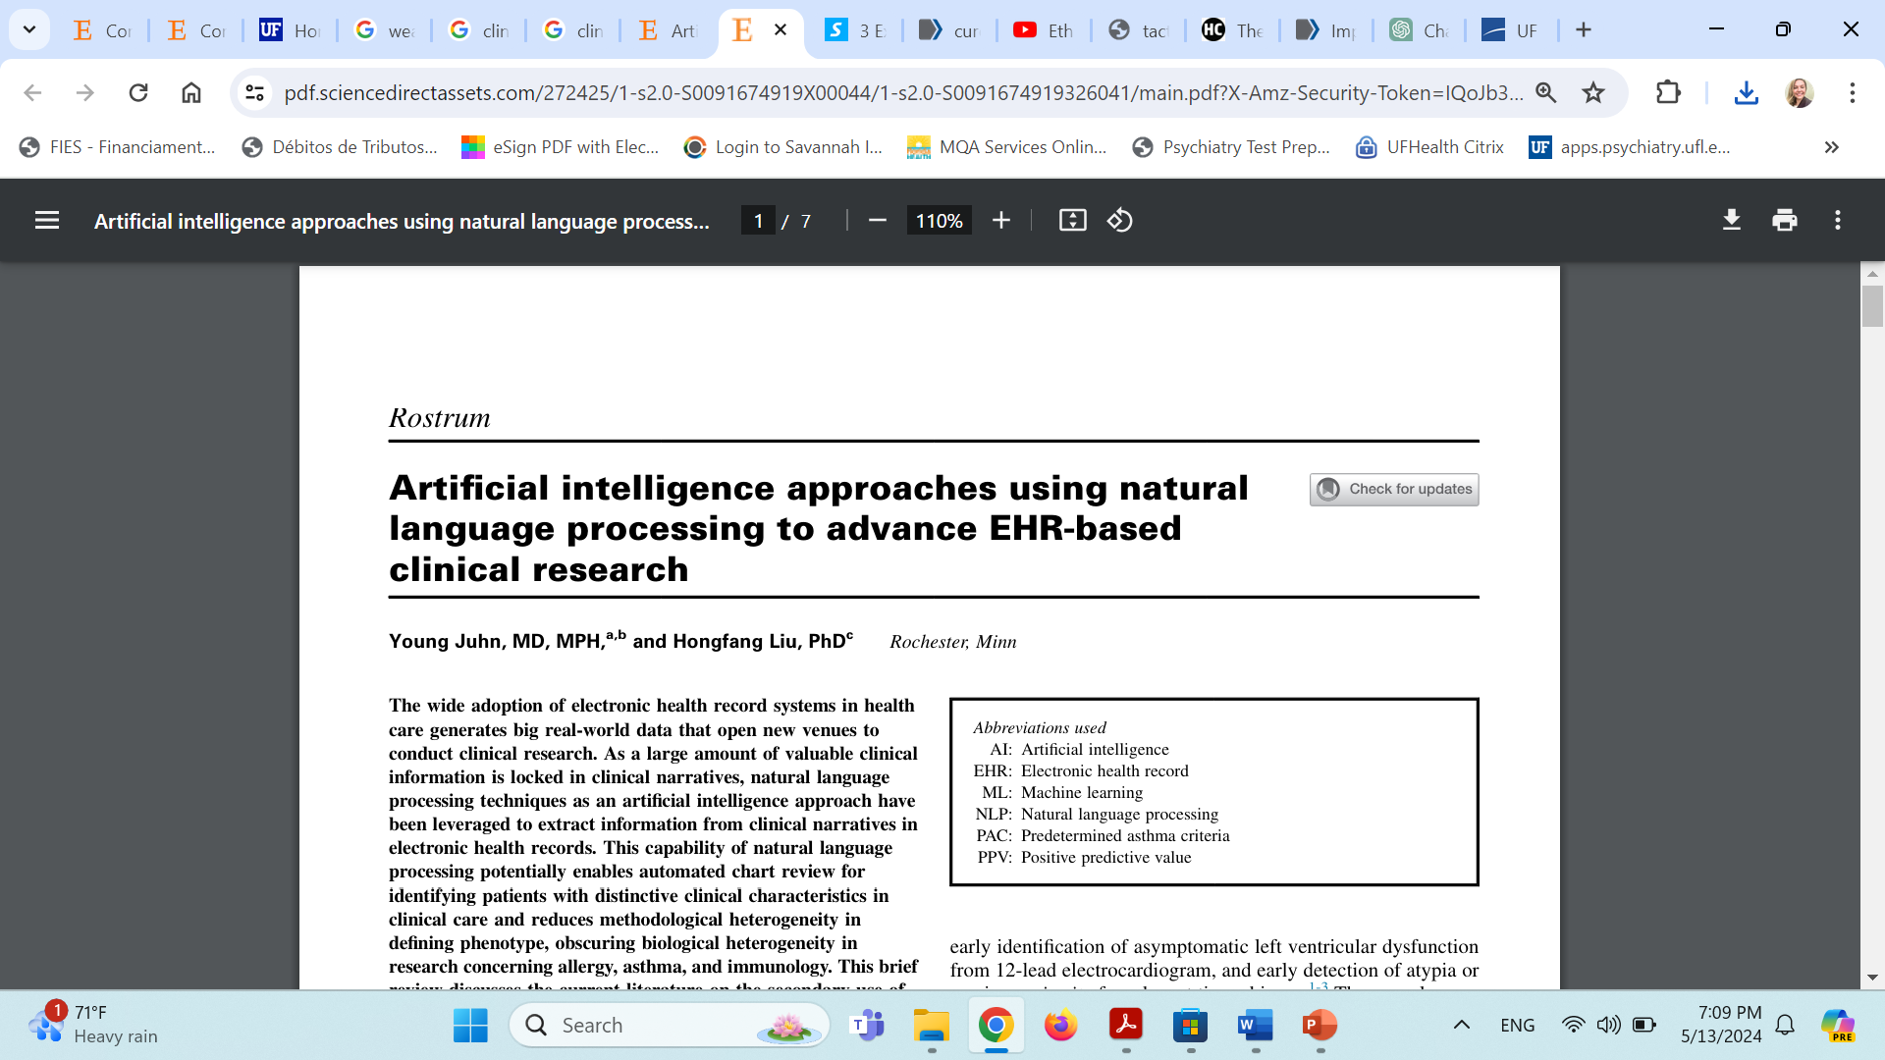
AI In Medicine
Notes:
Clinical Decision Support Systems are empowering healthcare providers to make evidence-based decisions by synthesizing vast amounts of patient data, medical literature, and best practices. While natural language processing programs are automating documentation, converting spoken or written patient notes into structured electronic health records, further streamlining clinical workflows, and enhancing the accessibility of patient information.

Slide 6

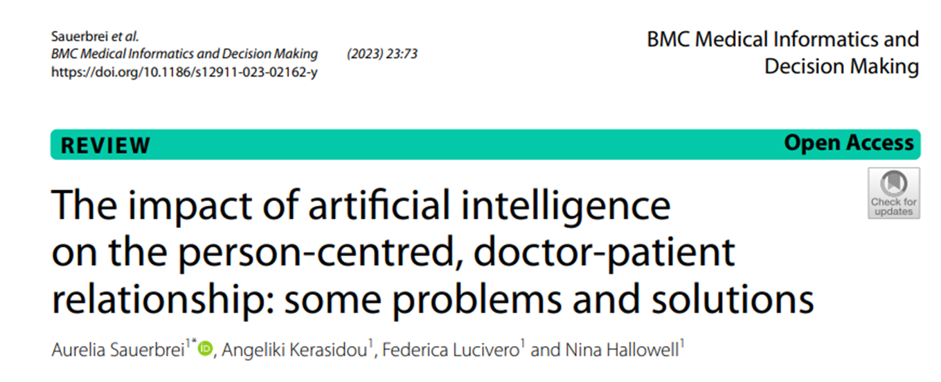

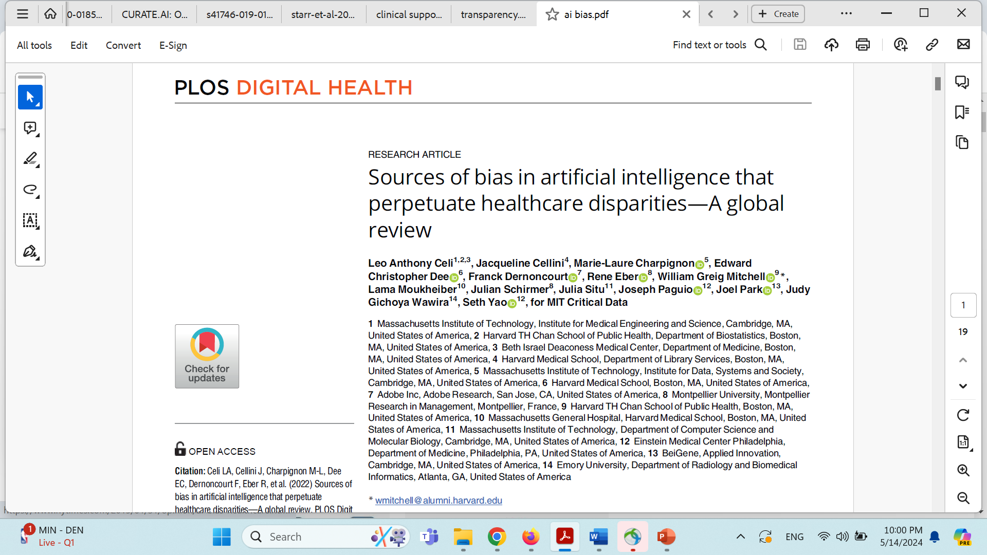
The Interface of Bioethics and AI in Healthcare
Coded Bias
Bias in Data
Privacy Concerns
Overreliance on technology
Lack of Transparency
Algorithmic errors
Other ethical dilemmas
Notes:
However, as we consider AI tools as a possible solution to current issues faced by healthcare systems, we also need to consider that, because of its novelty, there is very little concrete evidence on their impact on the doctor-patient relationship or on how to ensure that they are implemented in a way which is beneficial for person-centered care. The benefits of AI must be aligned with preserving patients’ autonomy and ensuring that their values and preferences are respected. Additionally, as we have learned from other fields, there are several aspects that we need to consider on the interface of AI and Bioethics, such as 1. Bias in data, 2. 5. Algorithmic ePrivacy concerns, 3. Overreliance in technology, 4. Lack of transparency, rrors, and 6. Other ethical dilemmas. Addressing these challenges requires careful consideration of ethical, regulatory, and technical aspects to ensure that AI technologies are developed and deployed in ways that maximize their benefits while minimizing potential harm.

Slide 7
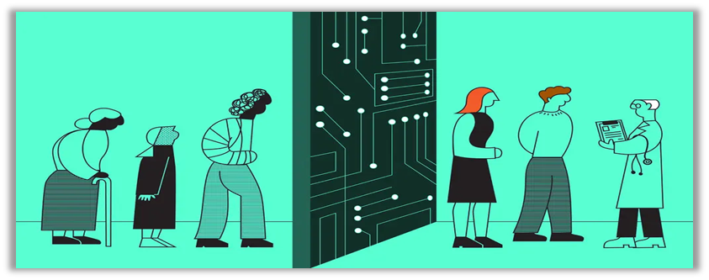
Bias in data
“While AI offers possibilities of advanced clinical prediction and decision-making in healthcare, models trained on relatively homogeneous datasets, and populations poorly-representative of underlying diversity, limits generalizability and risks biased AI-based decisions”
Celi at all, 2022 – over half of the database used to train AI models came from the USA or China
More than half of the authors contributing to these clinical AI manuscripts had non-clinical backgrounds and were three times more likely to be male than female.
Algorithm training and Scalability
Notes:
In terms of Biased data. We have to remember that AI algorithms learn patterns and make decisions based on the data they are trained on. And who feeds the system with this data it is us – humans, intrinsically “infected” with explicit or implicit bias. If the training data is biased or incomplete, the AI system may replicate and perpetuate those biases, which becomes a big problem in terms of scalability. For example, if you have some type of implicit bias – that will be replicated to the amount of patients you directly take care of – which is about 20000 to 30k the number of patients that doctors that care in their lifetime. Now when AI is making biased recommendations, we are talking about decisions that will impact hundreds of millions of patients. So For example, if historical healthcare data disproportionately represents certain demographic groups or contains systemic biases, the AI system may exhibit similar biases in its predictions or recommendations. Celi at all, . Sources of bias in artificial intelligence that perpetuate healthcare disparities—A global review. PLOS Digital Health, March 2022 – over half of the database used to train AI models came from the USA or China and More than half of the authors contributing to these clinical AI manuscripts had non-clinical backgrounds and were three times more likely to be male than female – so further worsening bias in AI

Slide 8
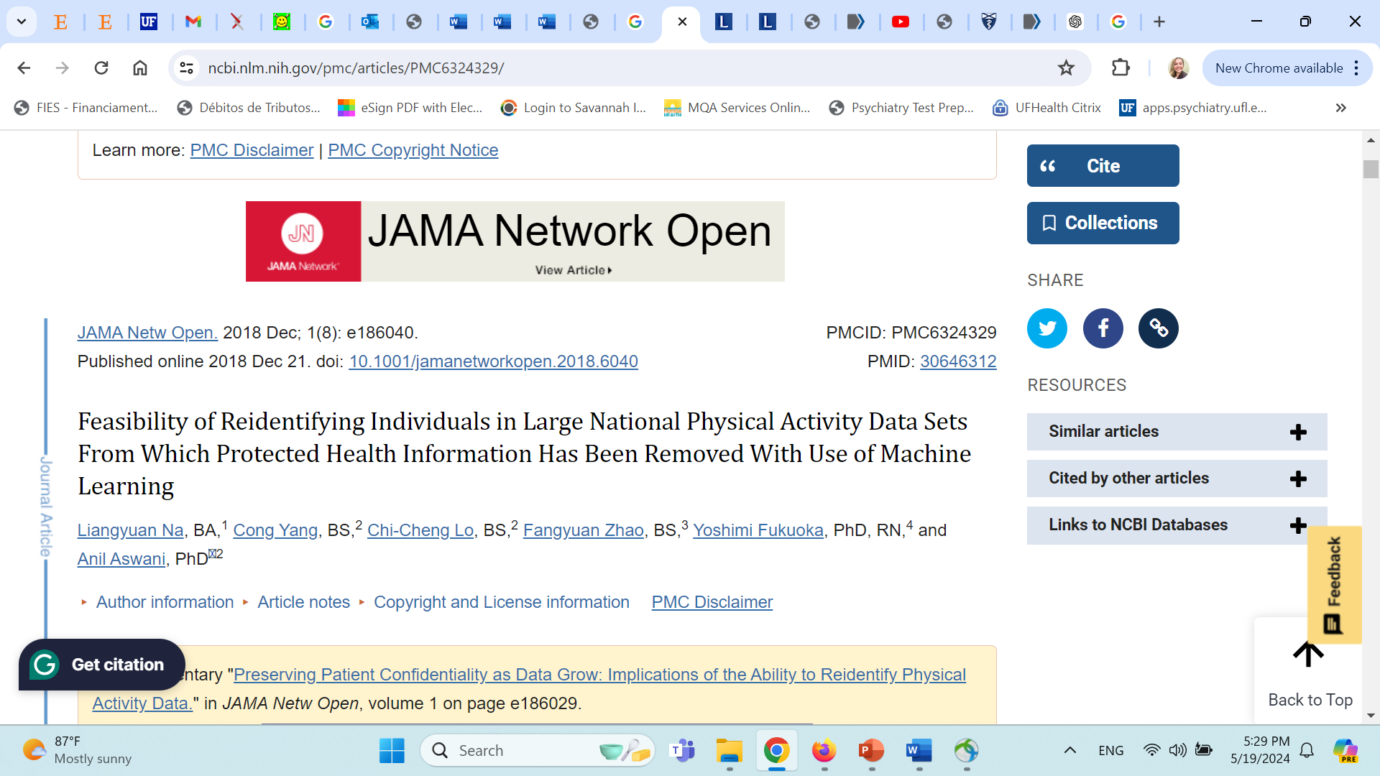
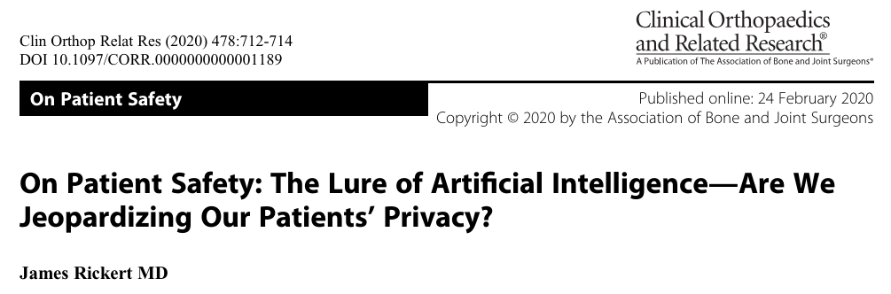
Privacy Concerns – “With Big Data come Big risks”
An algorithm could re-identify 85.6% of adults and 69.8% of children in a physical activity cohort study, despite the removal of identifiers of protected health information.
Technology companies need vast quantities of patient data to build and train machine-learning AI systems. Eg: Google is training its systems using millions of patient records hospital system.
HIPPA law must deidentify patient data prior to sharing
Alliances between technology companies and medical providers = privacy risks (data breech, reidentification via data triangulation).
Notes:
Patients may be hesitant to share sensitive information if they perceive that AI systems could compromise their privacy or security. There have been studies showing how newer algorithms are capable of identifying people from public and private data repositories. For example, a study from Na et al published in JAMA in 2018 analyzed data sets from National Health and Nutrition Examination Survey and found that an algorithm could be used to re-identify 85.6% of adults and 69.8% of children in a physical activity cohort study, despite the supposed removal of identifiers of protected health information.
“With big data come big risks and challenges” - among them significant questions about patient privacy.
Another concern regarding privacy is what we call data triangulation: According to HIPAA law, healthcare staff must de-identify patient data prior to sharing, whatever is the occasion under HIPAA regulations. However, there is no legal ban to stop technology companies (such as Google, Apple, and Meta) from reidentifying patient records. For example, Facebook/Meta is being sued for having access to PHI. Meta encouraged health-care providers to install the Facebook pixel on their websites and share protected information with it. Then, it matched the information it collected from pixel with Facebook user IDs, targeting those users with advertising without their consent.
So, Fear of data misuse or unauthorized access may lead patients to withhold information from healthcare providers, thereby limiting their ability to receive personalized care and make autonomous decisions.

Slide 9
Privacy Concerns
UNESCO Recommendations on the Ethics of Artificial Intelligence (2021)
European Union General Data Protection Regulation (2016)
Disclosure and privacy practices should reflect any data-sharing activities that involve patients’ EHR data.
EHR data should be deidentified according to HIPAA before sharing them with third parties for research purposes— They should consider using an independent multidisciplinary committee to assess certain uses and disclosures of deidentified datasets, including reidentification risks.
Hospitals should get prior written authorization from patients, institutional review board approval, and/or sign a DUA that adequately protects the data and prohibits reidentification. They should also carefully verify whether they really share—vs actually sell—the PHI under HIPAA.
Nunez and Gerke, Health Care AI and Patient Privacy—Dinerstein v Google. JAMA, March 2024
Learning objective: Previous 3 slides Describe Impact of AI on Patient Autonomy
Notes:
So what can be done to ensure that patients data is protected from AI instruments in the context of their hospitalization? Well there are National and international guidelines that covers privacy concerns in AI, such as Unesco Recommendations on the Ethics of Artificial Intelligence (2021) and the European Union General Data Protection Regulation (2016), both enforcing data protection as a fundamental right. A good summary of good practices in this matter can be found at the JAMA’s opinion section from March 2024, entitled Health Care AI and Patient Privacy—Dinerstein v Google, where they review the repercussions of a lawsuit claiming that a hospital violated patients’ privacy by sharing electronic health record (EHR) data with Google for medical artificial intelligence (AI) development. Some lessons to be learned from this include: 1. disclosure and privacy practices should reflect any data-sharing activities that involve patients’ EHR data, 2. EHR data should be deidentified according to HIPAA before sharing them with third parties for research purposes— They should consider using an independent multidisciplinary committee to assess certain uses and disclosures of deidentified datasets, including reidentification risks, and 3. hospitals should get prior written authorization from patients, institutional review board approval, and/or sign a DUA that adequately protects the data and prohibits reidentification. They should also carefully verify whether they really share—vs actually sell—the PHI under HIPAA.

Slide 10
Autonomy in Hospitalized Patients
Autonomy is a cornerstone principle of bioethics.
Respecting patient autonomy is classically discussed in terms of honesty from clinicians, informed consent and shared decision-making
Hospitalized patients:
Threefold disadvantage: institutional, existential and cognitive
More susceptible to the power imbalances in the physician-patient relationships
Sense of powerlessness and lack or autonomy.
Notes:
When we look at these aspects In the context of hospitalized patients, the Bioethical concerns are even greater. The Sweden author Kristensson Uggla says that when somebody becomes a patient, they tend to be at a threefold disadvantage related to the health care system - An institutional disadvantage because health care is an organization of strong hierarchy where the patient is located near the bottom. An existential disadvantage in terms of the vulnerability of being a patient and struggling with health issues. And a cognitive disadvantage, as patients might not be familiar with the rules and norms of the healthcare system.
Hospitalized patients not only are more susceptible for the inherent power imbalances in the physician-patient relationships, and all these can exacerbate their sense of agency and autonomy.
Autonomy is a cornerstone principle of bioethics. Respecting patient autonomy is classically discussed in terms of honesty from clinicians, informed consent and shared decision-making and over this foundation AI tools must be developed.

Slide 11
What AI Guidelines Mitigate Ethics Risk
Codes of Ethics
Proposed Legislation
International Legislation
Local legislation
Regulatory Requirements
Compare with Institutional Review Boards
AI Advisory Boards *
* A new entity

Slide 12
UNESCO’S 15 BIOETHICAL PRINCIPLES
 | Human Dignity and Human Rights | Autonomy and individual responsibility | Benefit and Harm | Privacy and Confidentiality | Consent
 | Equality Justice and Equity | Persons without Capacity to Consent | Human vulnerability and personal integrity | Non-discrimination | Respect for Cultural diversity
 | Solidarity and Cooperation | Social Responsibility and Health | Sharing of Benefits | Protecting Future Generations | Protecting Biodiversity, Biosphere and Environment

Slide 13


UNESCO’S 10 ETHICAL PRINCIPLES FOR AI
 | Human Dignity and Human Rights | Do NO Harm | Safety and Security | Fairness and nondiscrimination | Privacy
 | Sustainability | Human oversight and determination | Transparency and explainability | Responsibility and accountability | Multistakeholder collaboration and governance

Slide 14
Clinical Documentation
Including patient interviews
Quality Control
Compliance (policies and process)
Performance (competencies and outcomes)
Predictive Analytics
Decision Support
Capacity assessment, medication selection, symptom monitoring
Education and Training
Anticipated use of AI
For Patient Care
UFHealth 2024

Slide 15
My imaginary friend CHIP
A multimodal AI program. Is he ethical ?
CHIP - Computer Human Integrated Program
    – not yet but could be now NOW available*
Fund of information and retrieval ( world web of knowledge)
Conversational and with excellent writing skills
Accessible on cell phone or replacement
Personalized
Trainable for professional tasks
  Interviewing, writing, coaching
Stigmatized and discriminated against
Has to been coached against rude and retaliatory behaviors

Slide 16
CHIP –
In development
Co-Pilot Real time consultation
Synthesia AI Video
View 90 second video of
AI assisted staff training
Similar to the “It’s Possible Series” in EPIC.
Soon can be a dynamic chatbot and not static lesson
Demo of real time untrained consultation
Advanced model will be trained an vetted
Merge the Audio Chatbot with video avatar for greater impact
Learning objective: Demonstrate Understanding Informed Consent

Slide 17
UF Health Integrated Data Repository (IDR)
290,482,002 clinical notes
2,476,628 patients
Collected from 2011-2021
  from over 126 clinical departments UFHealth
  and approximately 50 million encounters
  covering healthcare settings including but not limited to inpatient, outpatient, and emergency department visits.
>82 billion medical words included after preprocessing and deidentification, **
17
** Xi Yang et al 2022 A large Language model for EHR

Slide 18
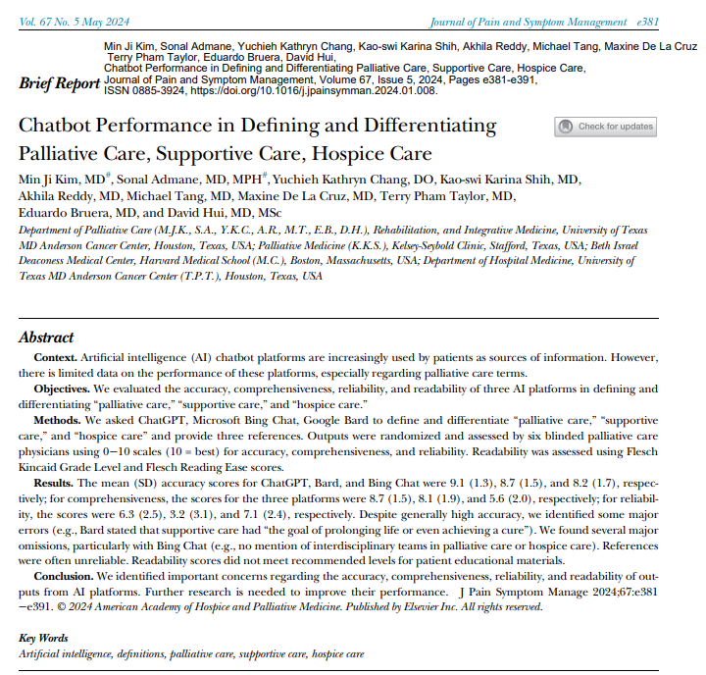
GPT to Provide Information to Clinicians
The study evaluated the performance of three AI chatbot platforms—ChatGPT, Google Bard, and Microsoft Bing Chat—in defining and differentiating palliative care, supportive care, and hospice care.
The chatbots were assessed for accuracy, comprehensiveness, reliability of references, and readability.
Results showed that while the chatbots generally provided accurate information, there were notable errors and omissions, particularly in comprehensiveness and reliability of references.
Readability scores indicated the content was more complex than recommended for patient educational materials.
The study concluded that improvements are needed in the AI platforms before they can be reliably used as sources of information for patients and healthcare pro
[Summary provided by Co-Pilot and vetted by JT]. 🌟

Slide 19
Conducting the Capacity Assessment
GPT to coach the physician for the assessment:
e.g. Co-pilot demo
GPT Agent to interview patient and offer initial opinion

Slide 20
Autonomy in Hospitalized Patients
How AI tools can assist with supporting the autonomy of hospitalized patients?
In real time, guiding the clinician in conducting the capacity assessment
Using precision medicine tools, assist the clinician in using patient specific parameters for a more accurate risk/benefit assessment;
Present the material at the educational and emotional level of the patient.

Slide 21
Using precision medicine tools, assist for a more accurate risk/benefit assessment
GPT analysis of EHR for outcomes
GPT agent match patient characteristics with general outcomes and precise prognosis
GPT agent to interview patient values and match with intervention options

Slide 22
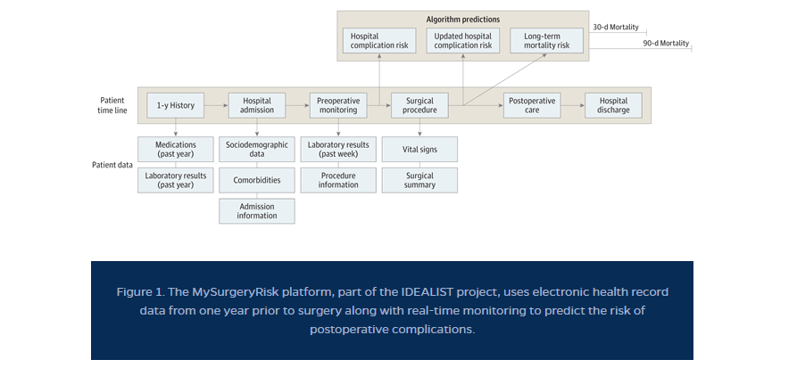
Precision Medicine - Predicting the Risk for the Individual Patient
IDEALIST » PRISMAp » College of Medicine » University of Florida (ufl.edu)

Slide 23
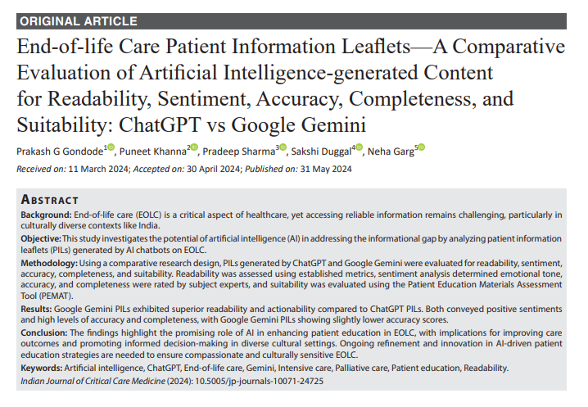
Individualized Patient Information
The study evaluated the effectiveness of AI-generated patient information leaflets (PILs) on end-of-life care (EOLC) by comparing content from ChatGPT and Google Gemini.
It assessed readability, sentiment, accuracy, completeness, and suitability.
Google Gemini’s PILs show better readability and actionability, while both platforms convey positive sentiments and high levels of accuracy and completeness.
The study suggests AI’s potential in enhancing EOLC patient education, emphasizing the need for ongoing AI innovation and culturally sensitive approaches to improve care outcomes and informed decision-making in diverse cultural settings.
The study also reflects on the broader implications for patient education and healthcare communication, calling for a patient-centered approach to leverage AI’s strengths in EOLC.
Effective communication, advance care planning, and practical support are key components.
Ultimately, end-of-life care is about honoring one’s wishes for a peaceful transition, emphasizing the importance of empathy, preparedness, and community support
[Summary provided by Co-Pilot and vetted by JT]. 🌟

Slide 24


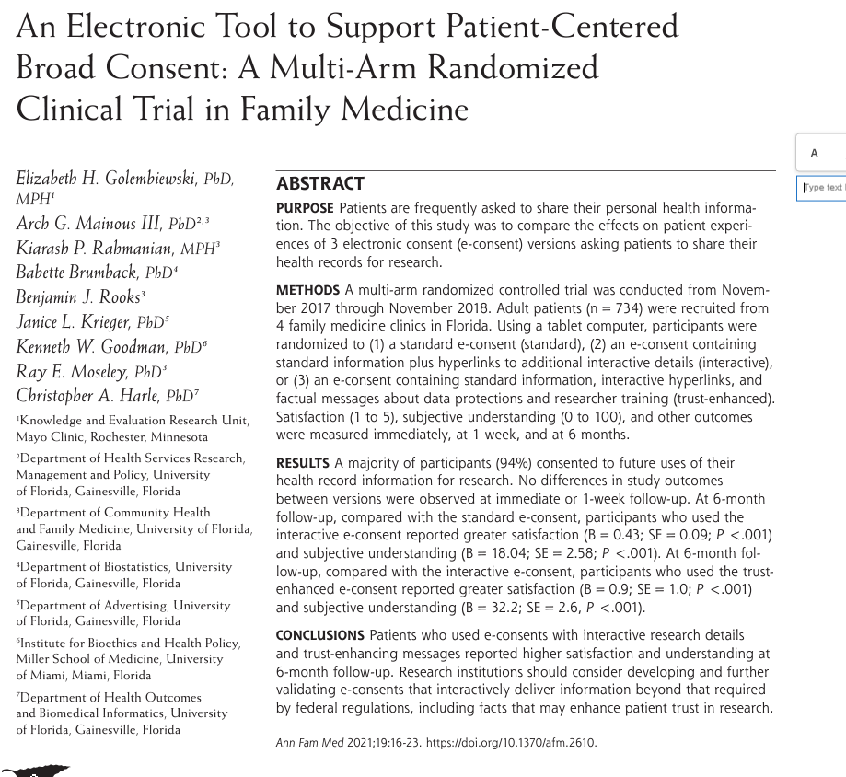
Engage Patient with Consent Process
This article not AI,
but could be replicated and implemented with GPT technology to scale.

Slide 25
Enhance the culture for patient autonomy by
providing administrative surveillance of informed consent procedures,
identify factors that enhance patient involvement in care, and
using predictive analytics, provide decision support systems to aid patients

Slide 26
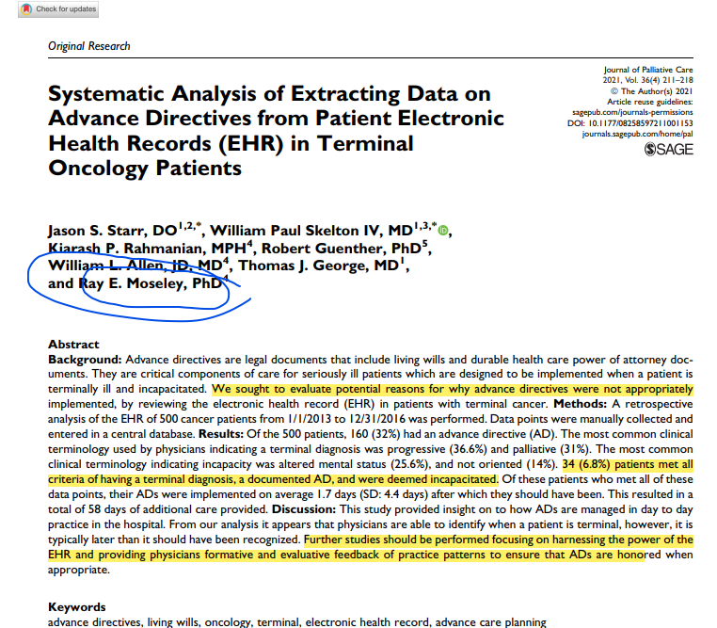
Support Advance Directives
Conduct NLP Surveillance of Records
Identify need for Advance Directives
Identify triggers for Advanced Directives

Slide 27
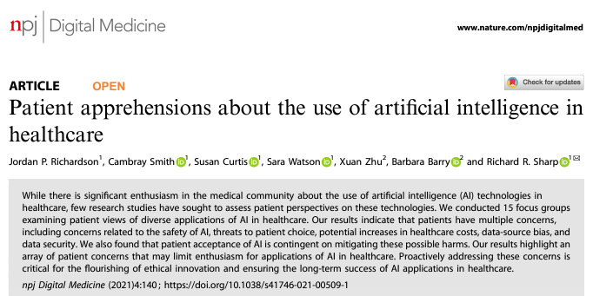
Voice of the Patient
Patient apprehensions about the use of artificial intelligence in healthcare - PMC (nih.gov)PMC (nih.gov)
Survey Study Found Multiple Concerns of Patients towards AI in healthcare
Proactively addressing these concerns may facilitate implementation

Slide 28
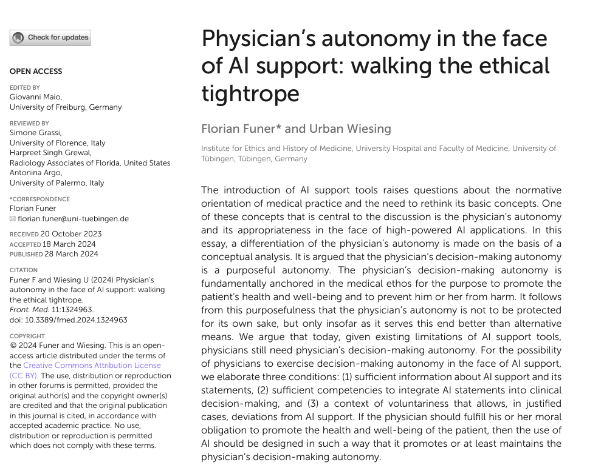
Physician Autonomy Supported by AI
Physician’s autonomy in the face of AI support: walking the ethical tightrope –
Physician decision making is a purposeful autonomy
This autonomy is a means, not an end, thus if decision making is assisted by AI all the better

Slide 29
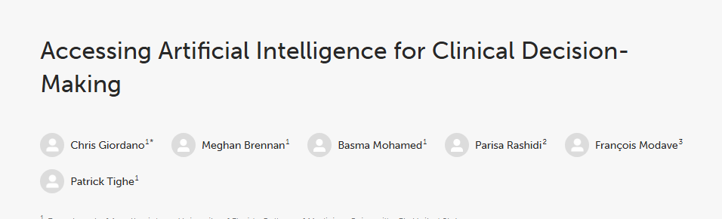
Implications for Training
The medical workforce must be re-trained to interpret AI guidance from complex data sets
Communicate these findings in a way understandable to the patient regardless of education, language or culture

Slide 30
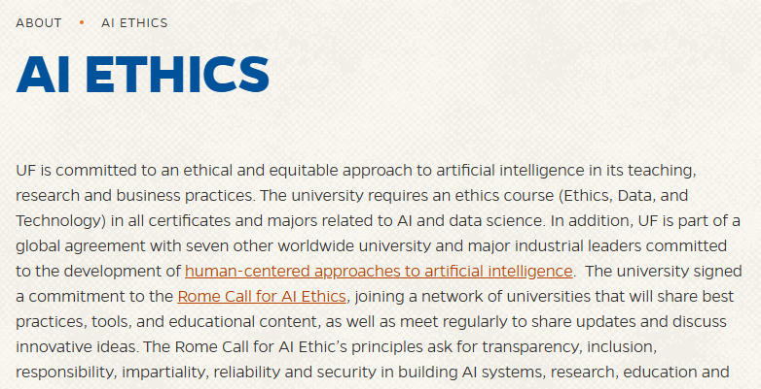

Slide 31
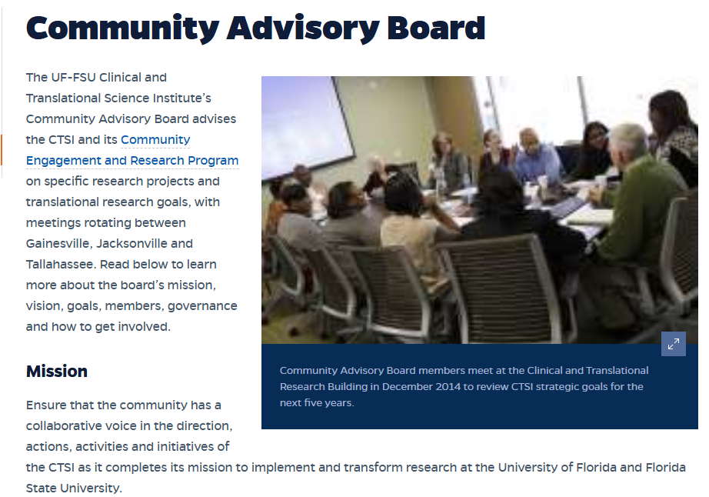

AI Ethics at UF
https://ai.ufl.edu/faculty/working-group-in-
ai-ethics-and-policy/
Policy overview, computer scientists, philosophy, law, sociology
Community Advisory Board » Clinical and
Translational Science Institute » University of Florida (ufl.edu)

Slide 32
AI Advisory Board
“They [Hospitals] should consider using an independent multidisciplinary committee to assess certain uses and disclosures of deidentified datasets, including reidentification risks”.
Nunez and Gerke, Health Care AI and Patient Privacy—Dinerstein v Google. JAMA, March 2024
Learning objective: Describe purpose of AI Advisory Board

Slide 33
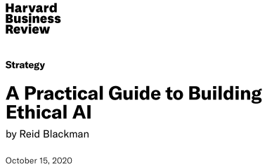
How to start an AI Ethics Board
1. Identify existing infrastructure tat a data and AI ethics program can leverage
2. Create a data and AI ethical risk framework that is tailored to our enterprise
3. Change how you think about ethics by taking cues from successes in health care
4. Optimize guidance and tools for product managers
5. Build organizational awareness

Slide 34
AI Advisory Board
What is the committee structure
Who is on the committee (s)
What qualifications
What authorities
What funding

Slide 35
Kickstart UF Health AI Advisory Board(s)
Begin with UF-VA Bioethics Unit
Formed 2015 with participation from VA, UFHealth, Medicine, Nursing, and Public Health Colleges
Online training
Grass roots community network during COVID
International network
Asynchronous meetings
Learner tailored training
Spur formation of other committees in the University

Slide 36
Thank you!
QUESTIONS ?

