Slide 1


Strategies to teach Ethics of AI
Joseph E Thornton, MD, DFAPA

Slide 2
Overview
What is AI
Ethics for AI
Codes of Ethics for AI
UNESCO Recommendations
Implementation
Teaching the Ethics of AI
Specialized programs eg HAI, Berkman Center, UNESCO Chair,
Corporate Programs ( GOOGLE AI) Pegasus, Coursera
Didactics, monographs, short videos, participatory, consultations
Strategies for Implementation of Teaching
International Chair in Bioethics
International Forum of Teachers, Department of Educations
Professionalize ICB by incorporating as the Society of ICB

Slide 3

What is AI

Slide 4
What is AI ?
Augmented Intelligence
Included digital healthcare, eg smartphones etc
Apparent Intelligence
Focused AI
Image recognition, speech recognition, search engines
Programmed
Chat boxes
Artificial Information
Fake information disseminated in order to influence behavior
Artificial Intelligence
Some activites that include novel problem sovling that can also be solve d by humans.
However, Computers can do the same work 10,000 times faster, thus would be smarter than any human without being more intelligent
There is fear (and evidence) that AI can develop novel intelligence that may be superior to humans
E.g Alcph GO

Slide 5
Uses of AI in Healthcare cf Mesko and Gorog 2020; Topol 2019; lee and touroous 2021
Consultations – AI does initial H&P
Medication Management – smart app to assist patients to organize and remember medications
Diagnostics – eg diagnostic ultrasounds using cell phone on self
Predictive analytics – detecting risk factors for suicide, overdose etc
Precision Medicine – using genomic data to select medications
Drug creation – matching molecular structures with therapeutic targets identified 2 existing drugs that could treat Ebola
Triage – during COVID who has been chance of survival with ICU care

Slide 6
Pathological AI
Artiifical information
Right reasoning but wrong data can lead to aberrant behaviors and violence
Biased reasoning
Right data but wrong paradigm for problem solving
Poorly controlled reasoning
Impulsive
Overly conservative

Slide 7

Ethics in AI

Slide 8
Cambridge Analytica (CA)
CA, a private company, supported another company, to provide to 387,000 users of faceboook an app that enabled it to collect data on the users and their friends and giving the company access to data on 50 million Facebook users
The Company CEO is quoted boasting they had “4,000 data points on 270 million American adults” to be used for psychological profiling.
The Company then marketed itself to political campaigns to assit the election of clients (all conservative nationalists).

Slide 9
Data security lessons
Company 1 collects data from person A with agreement to use it for restricted purposes.
Company 2 “tricks” person B into giving permission to access contacts and photos. Person B is friends with person A so person A information including photos, locations, associates and activities with Company 2 without permission or knowledge.
Company 2 uses emotional reinforcement techniques devised by academic psychologists to influence behavior of Persons A, B….

Slide 10
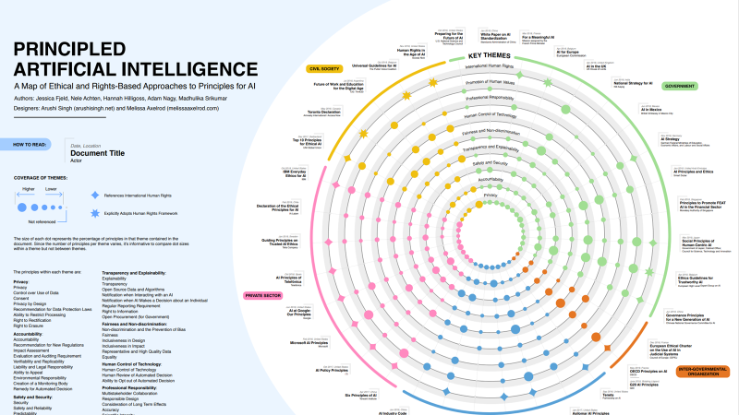
Codes of Ethics
Berkman Institute describes 47 codes
But add codes fo AI ethics for all major corporations, universities and governmental jurisdictions we can see thousands fo codes just as we do for other types of ethics
Do codes help or hurt to manage risks ?.

Slide 11
Unesco recommendations

Slide 12
UNESCO AI ETHICS PRINCIPLES
 | Human Dignity and Human rights | Do No Harm | Security and Safety | Fairness and non-discrimination | Privacy
 | Sustainability | Human Oversight and Determination | Transparency and explainability | Responsibility and Accountability | Multistakeholder collaboration and governance

Slide 13
Implementing ethics in ai

Slide 14

Teaching the ethics of ai

Slide 15

Specialized programs

Slide 16

Berkman Klein Center
Accounting for AI — a Comparison of Methods | Berkman Klein Center (harvard.edu)

Slide 17

Stanford Human AI
Home | Stanford HAI
Radical Proposal: Third-Party Auditor Access for AI Accountability (stanford.edu)

Slide 18
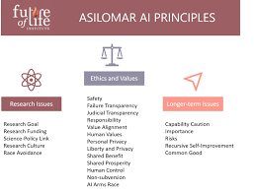
Future of Life Institute
Artificial Intelligence - Future of Life Institute

Slide 19
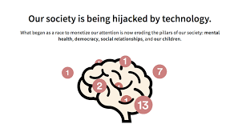
Center for Humane Technology
Who We Are (humanetech.com)

Slide 20

Corporate programs

Slide 21
Corporate certifications

Slide 22

University training

Slide 23
Strategies for implementation the teaching of ai

Slide 24
Lessons learned from bioethics
Needed through all ages of life cycle
Multiple modalities
Active learning (flip learning)
Case based
Just in time
Reinforced

Slide 25
Where to start
Incorporate material into existing courses, programs
Critically examine your digital environment for examples
Acquire AI tools to use for learning

Slide 26
AI Tools Used in this session Today
Natural Language Processing
Predictive Analytics
Speech Recognition
Image Recognition (face ID)

Slide 27
Next steps
Collaborate in a network of more and less experienced colleagues
ICB Department of Education
International Forum of Teachers
Other professional ethics groups, (mix AI content experts and Ethics process experts)
Your affiliate institutions and companies
UF-VA Bioethics Unit (Florida USA)
Professionalize by incorporating as a legal professional society
Funding for needs assessment surveys
Matching needs and resources

